Slide 1
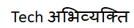





SOCIAL MEDIA
INSTAGRAM
FACEBOOK
FITNESS APPS
Nike Training Club
HEALTHIFYME
1.386 billion active users
2.96 billion active users
4.4 million active users
1.8 million active users

Slide 2

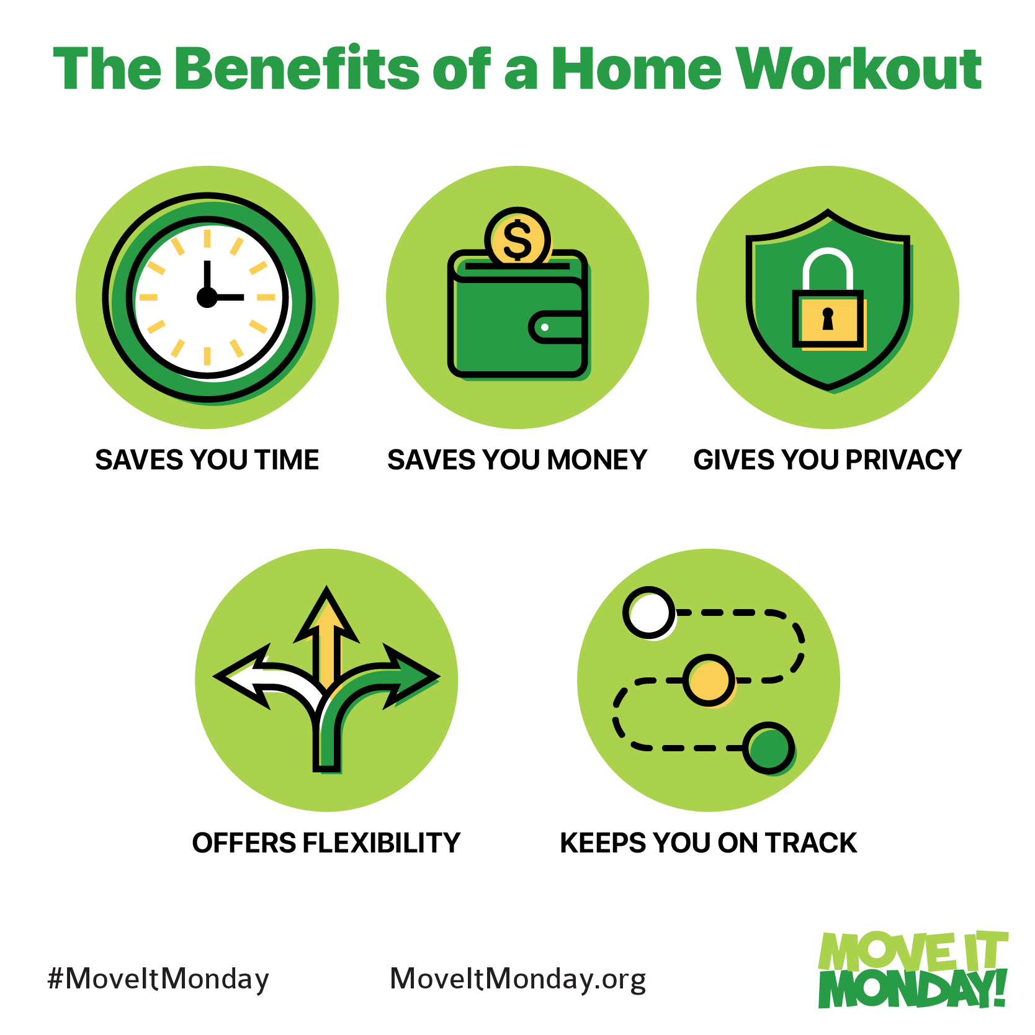
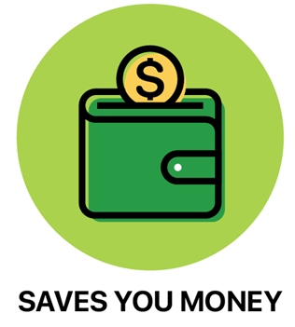


AT
HOME
WORKOUT
BENEFITS

Slide 3
PROBLEM STATEMENT
Lack of self motivation
Insufficient Time
CHALLENGES
OF HOME
WORKOUT
Inefficiency of personal goals
Monotonous Routine
Lack of knowledge

Slide 4
Connect with peers
Track your progress
Compare your progress
Workout with self, buddies and certified trainers
AI model to keep track of exercise count
Access to nutritive diet plans
IMPLEMENTATION: A SOCIAL MEDIA FITNESS APP

Slide 5

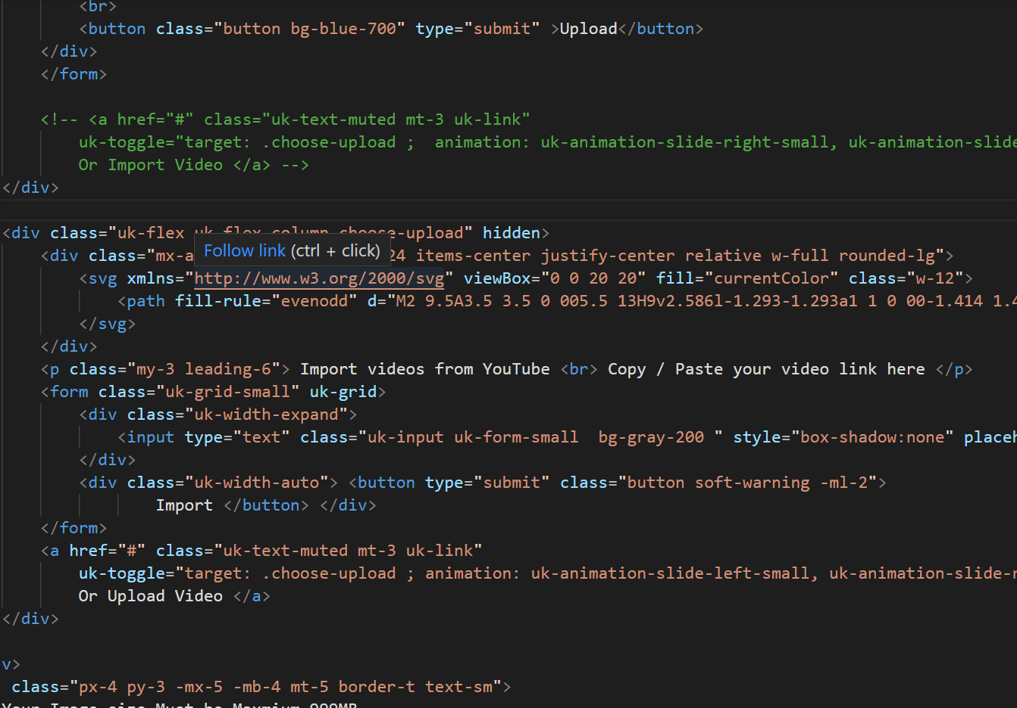
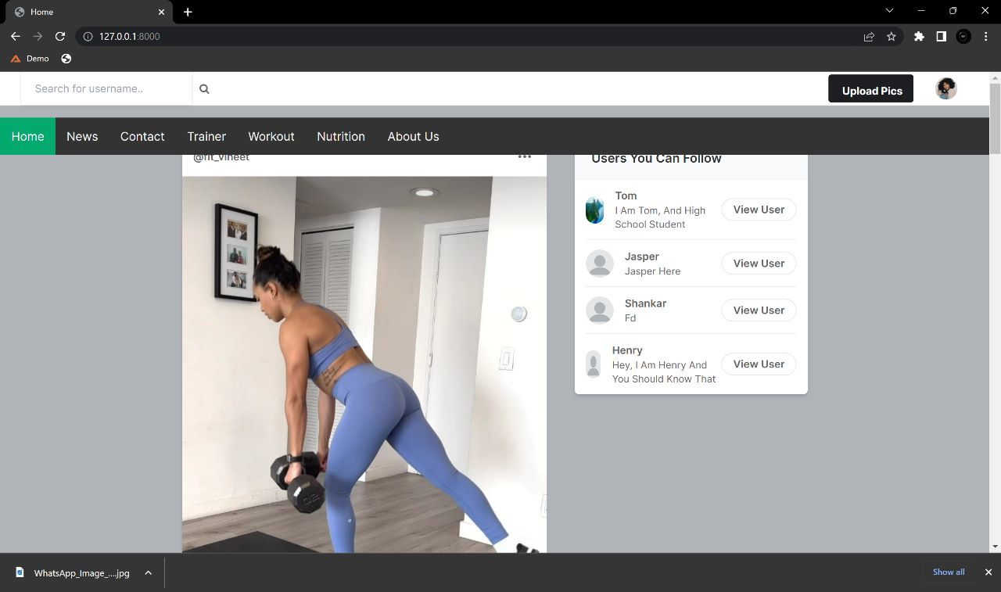
INTRODUCING FITTER HEALTH

Slide 6
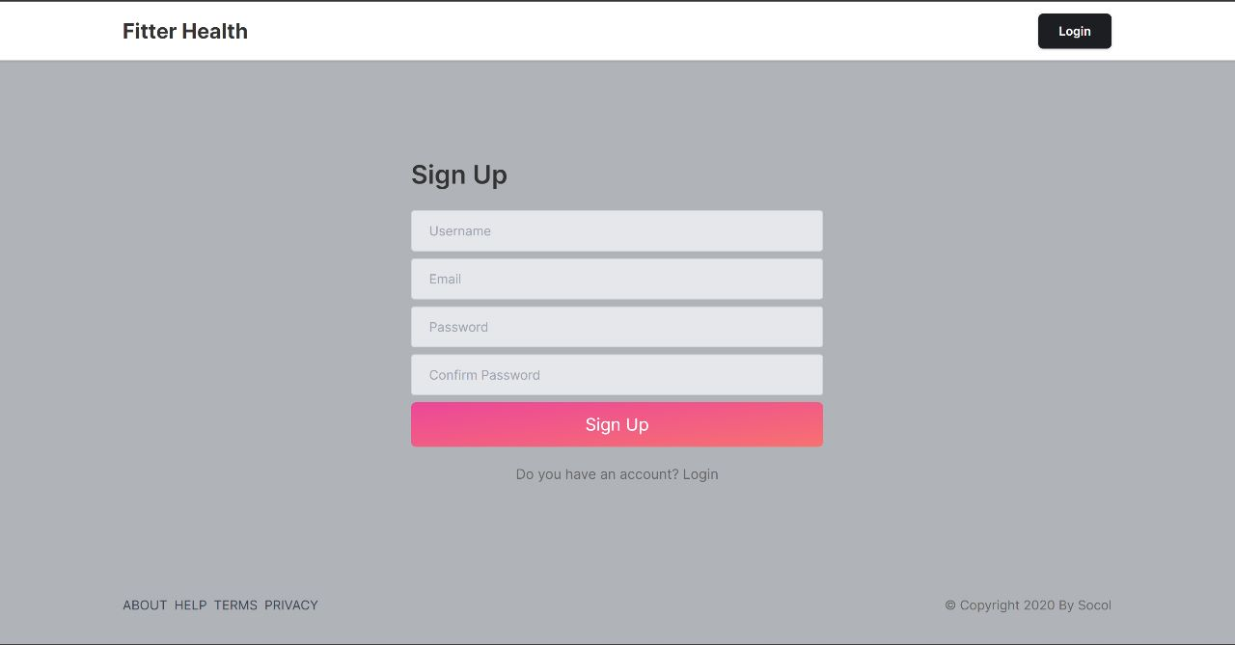
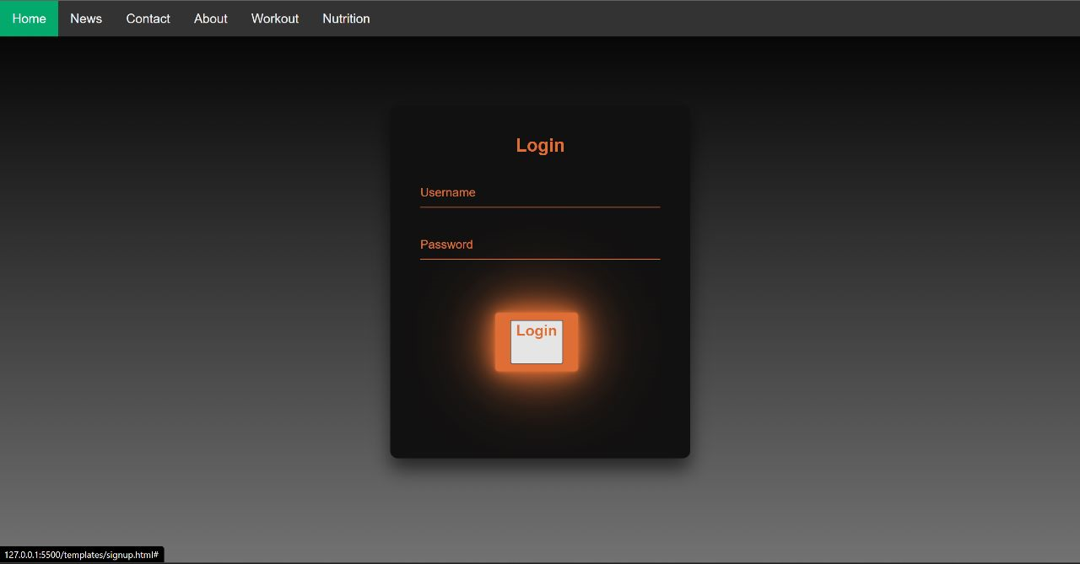
USER AUTHENTICATION

Slide 7
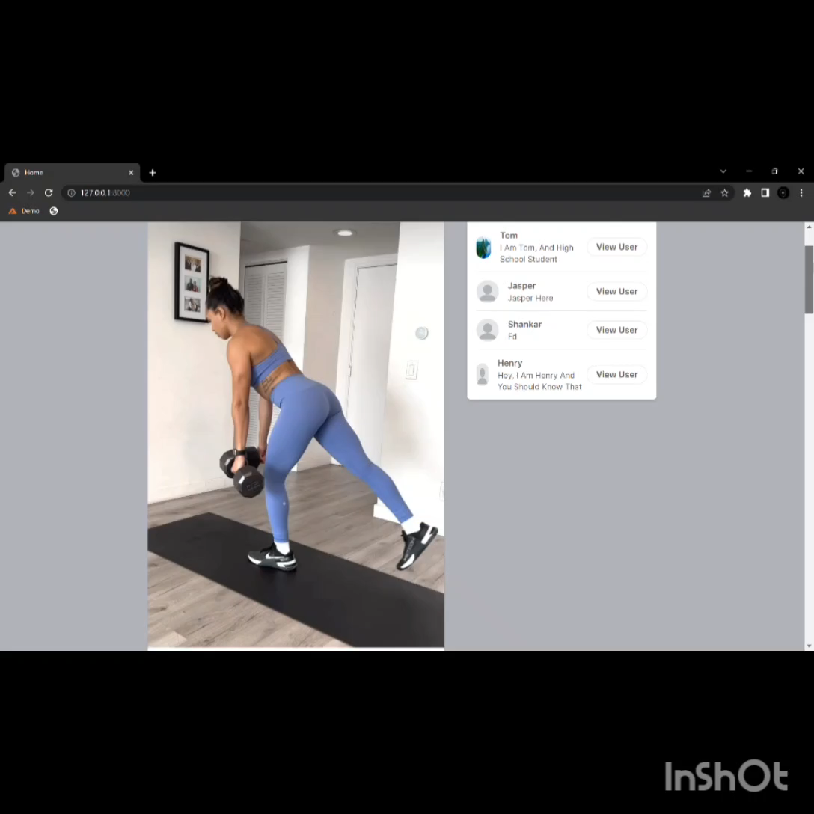
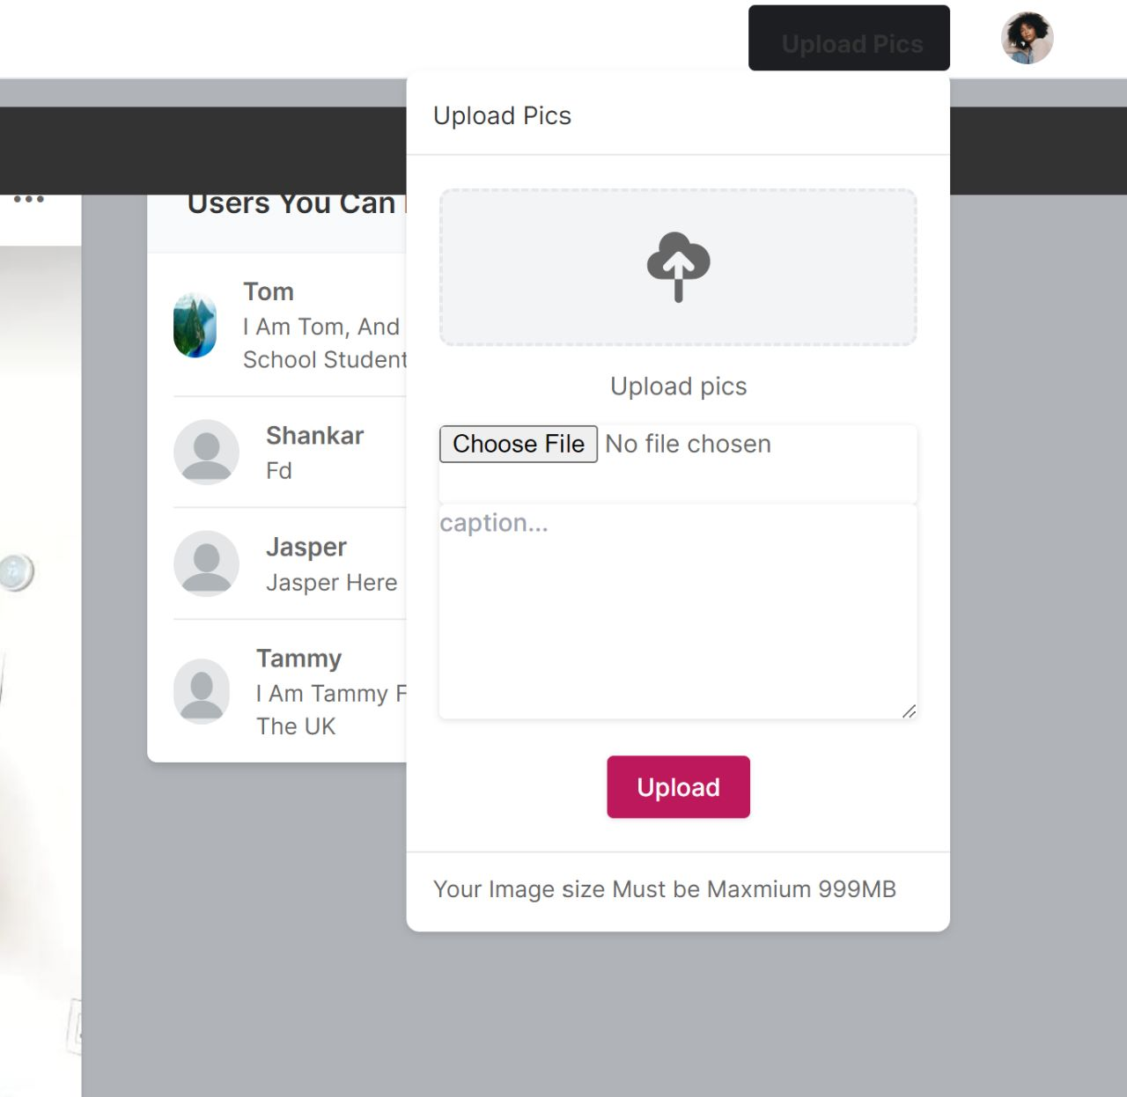
POST FEED

Slide 8
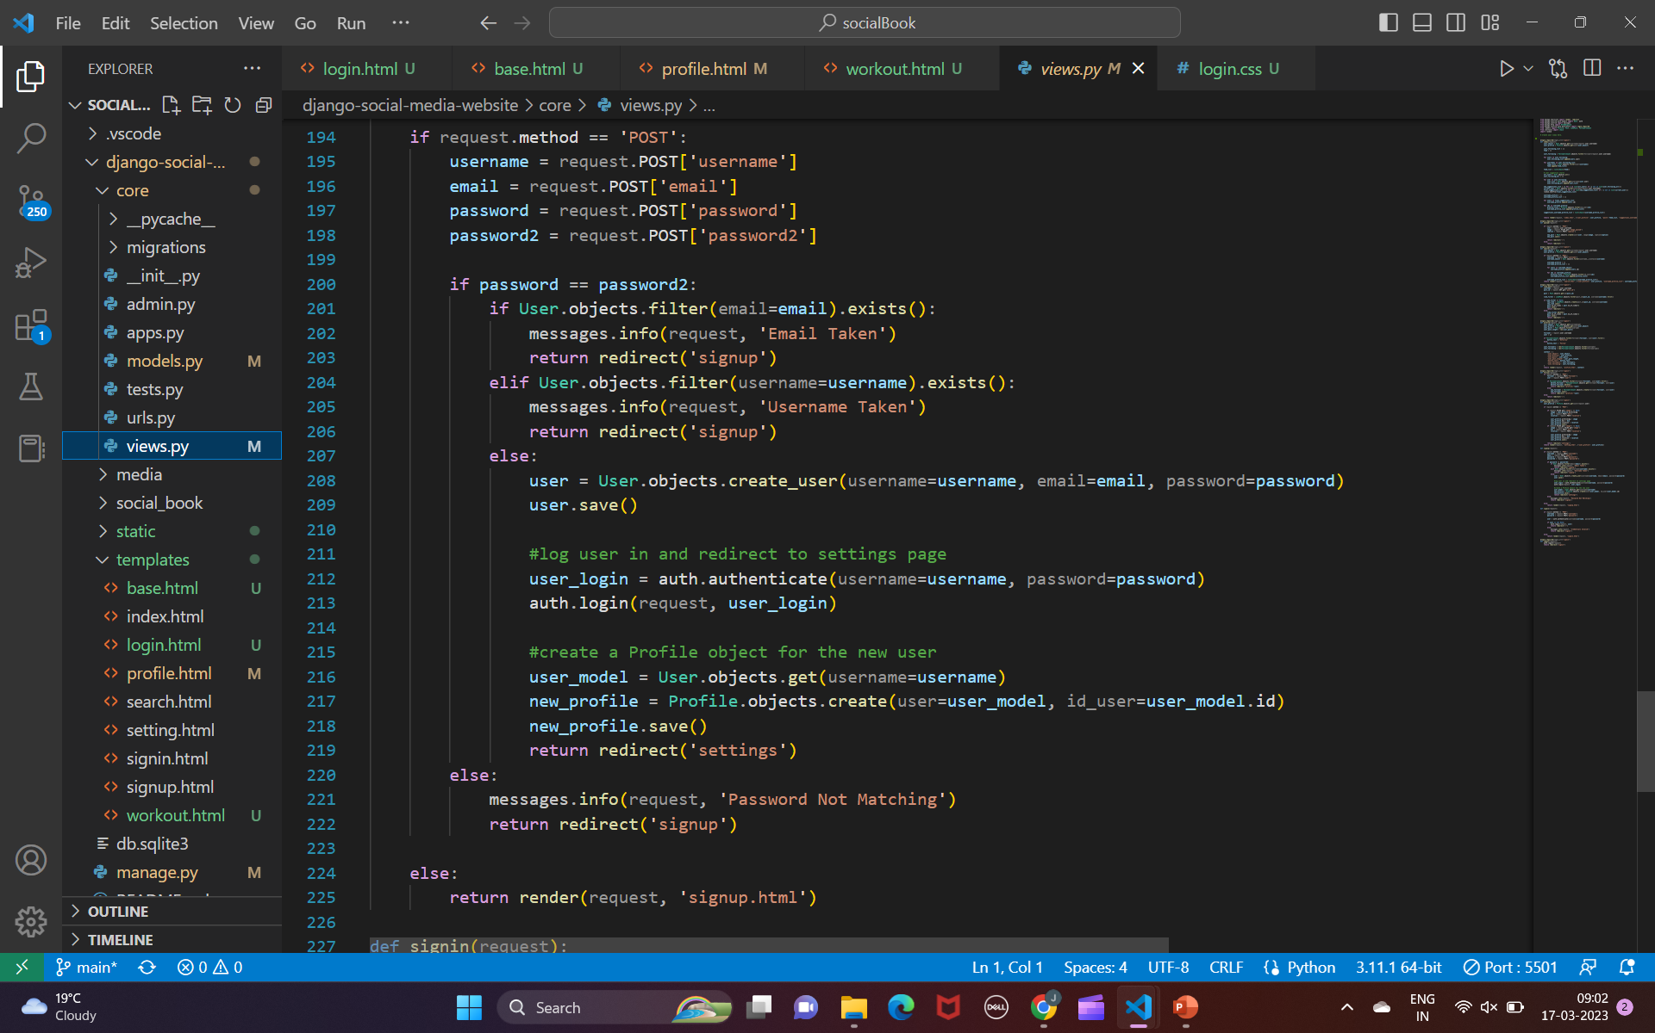
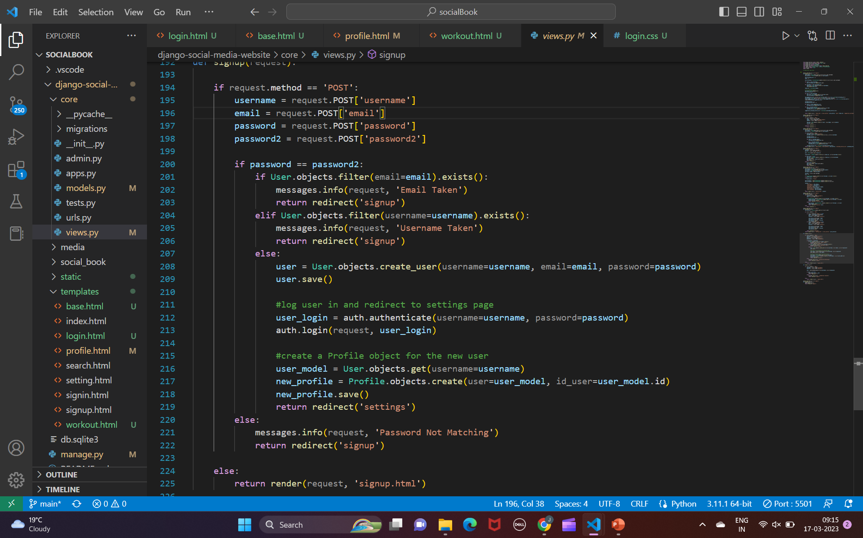
USER AUTHENTICATION: CODE SNIPPET

Slide 9
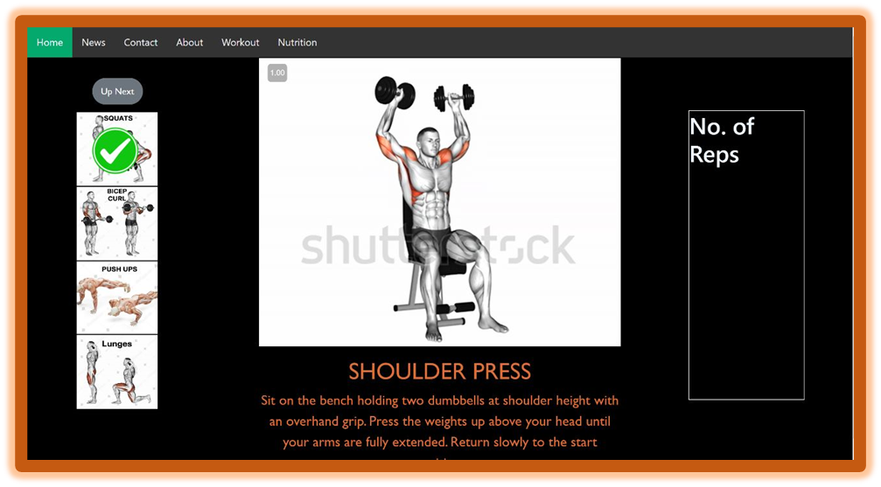
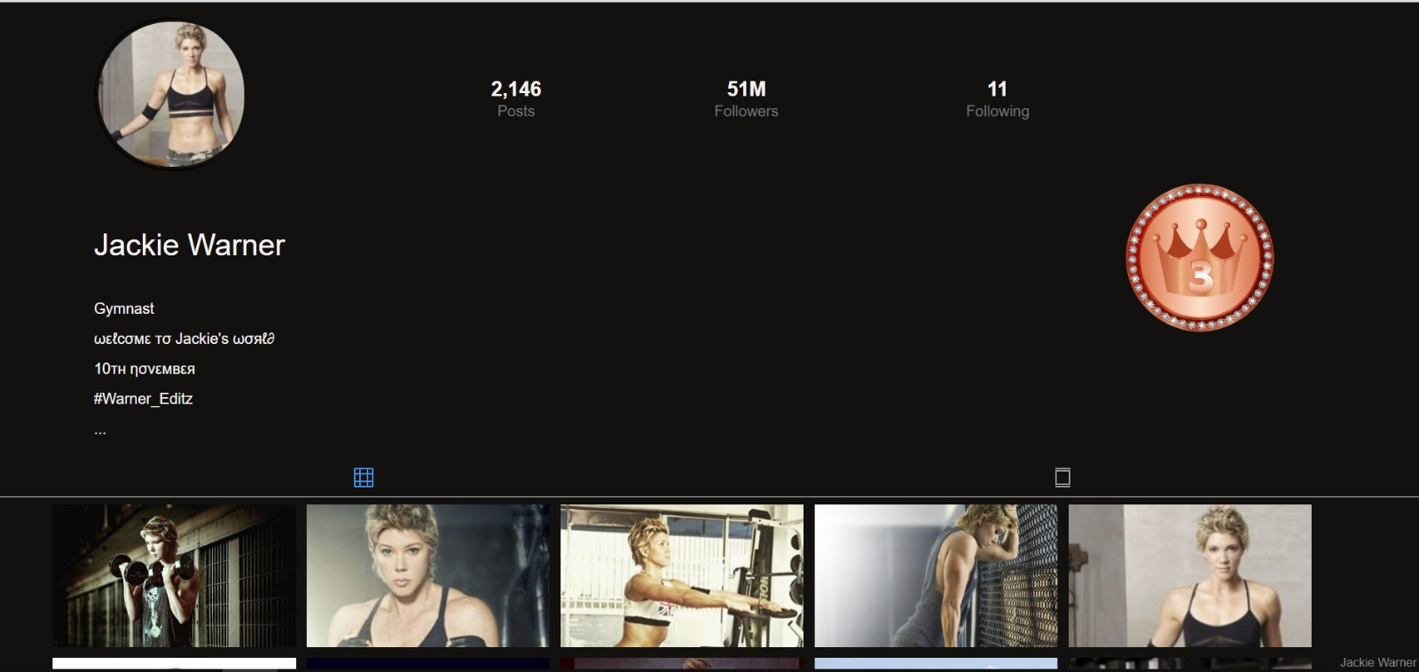
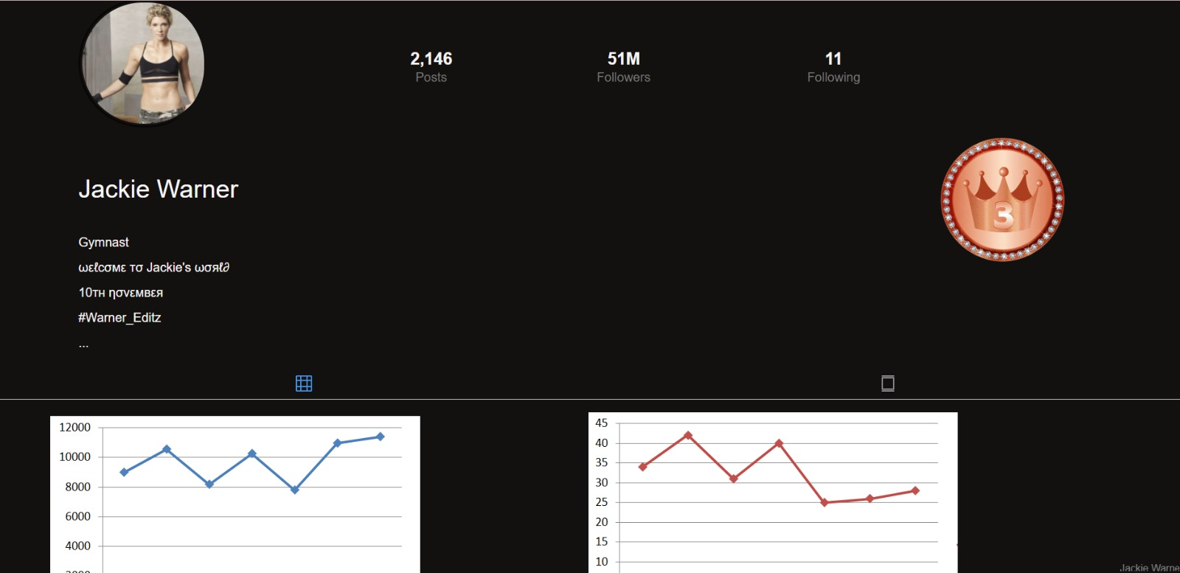
CREATE YOUR PROFILE

Slide 10
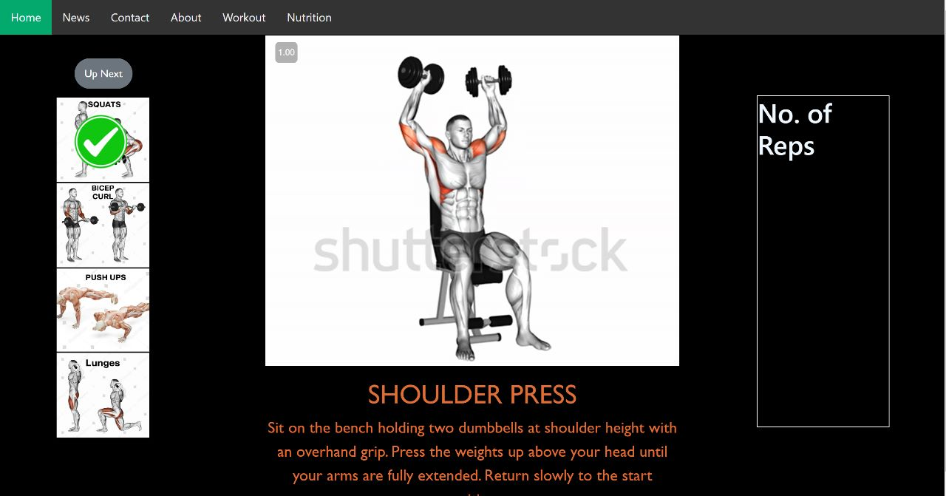
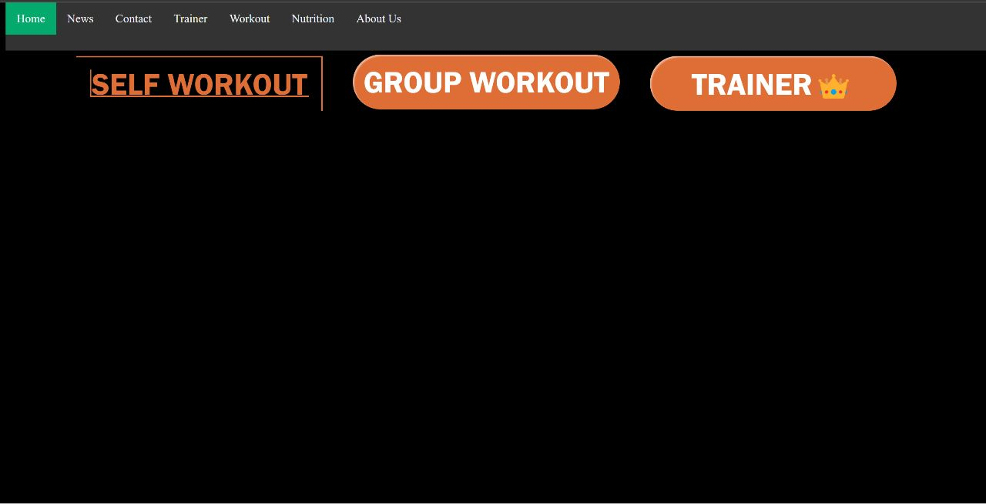
FRIENDS
CERTIFIED TRAINERS
SELF
WORKOUT WITH
7

Slide 11
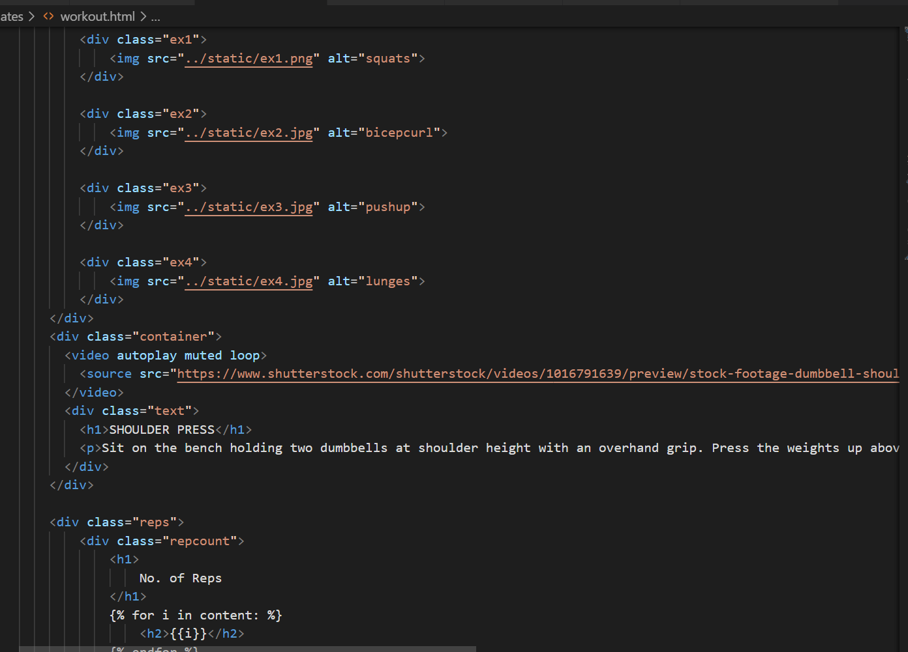
WORKOUT WITH SELF: CODE SNIPPET
7

Slide 12
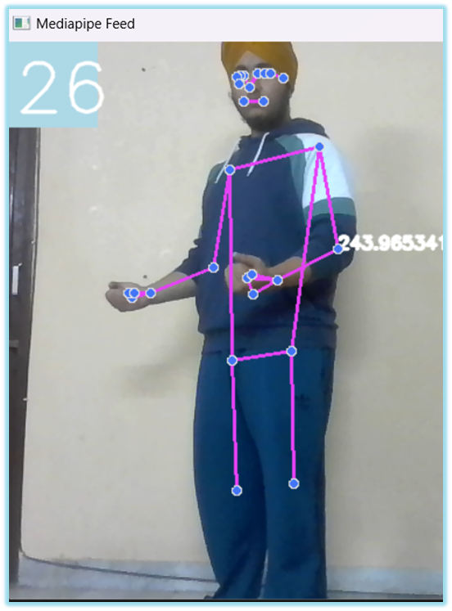
AI COUNT REPS

Slide 13
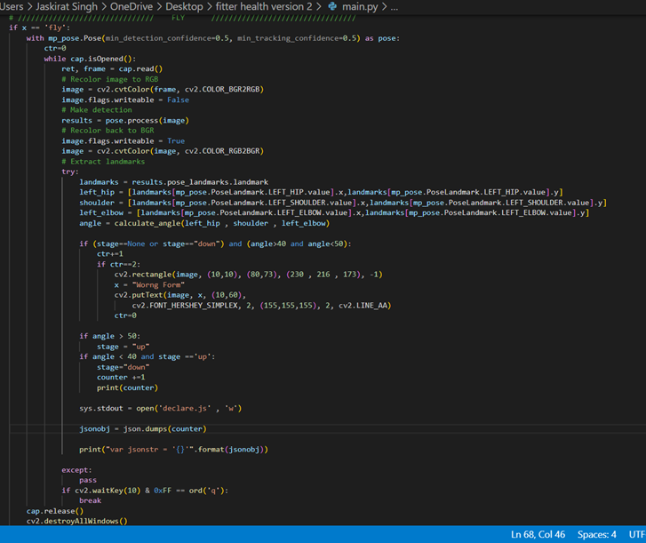
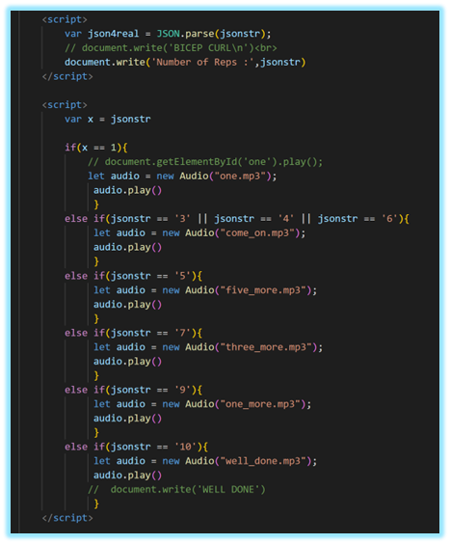
AI COUNT REPS / CODE SNIPPET

Slide 14
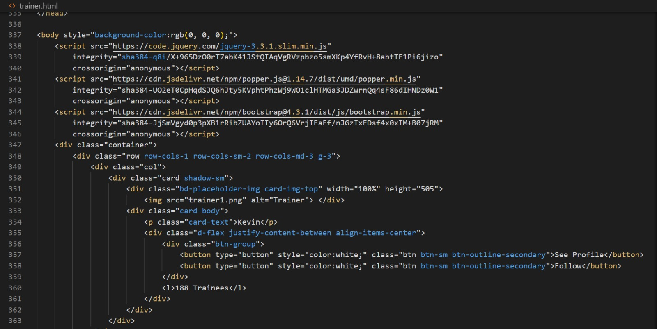
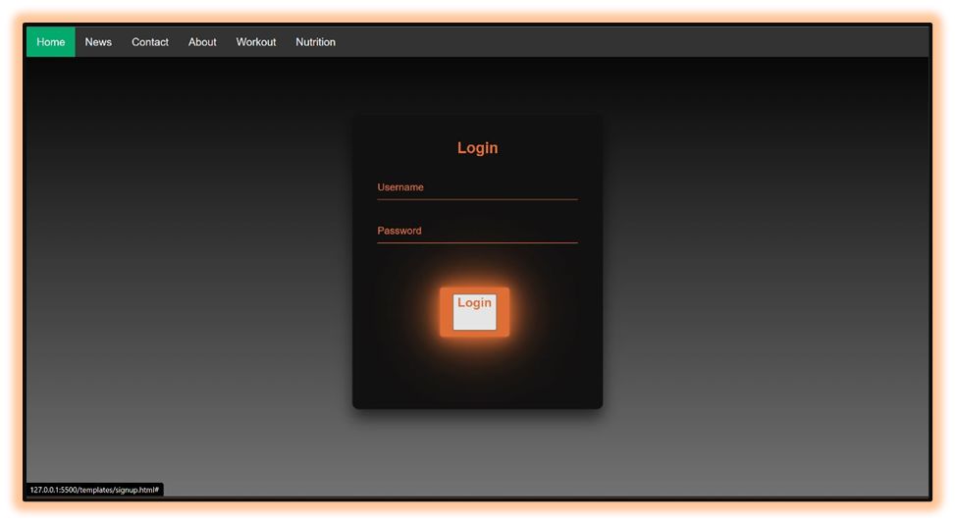
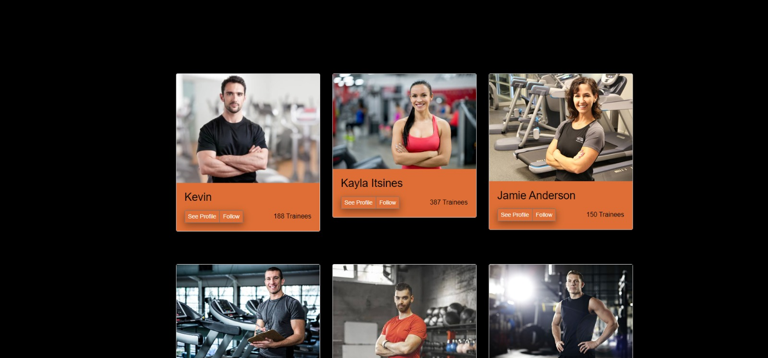
CHOOSE YOUR TRAINER
7

Slide 15
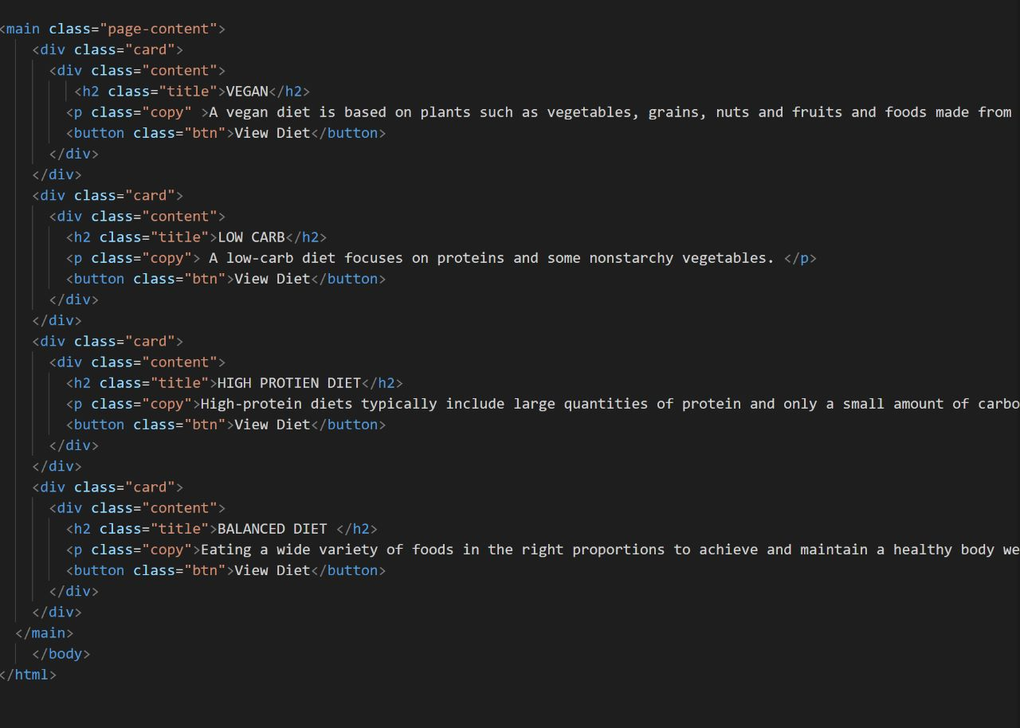

NUTRITION
7

Slide 16
TECH STACK
MEDIAPIPE
CSS
HTML
PYTHON
DJANGO
SQLITE
OPENCV

Slide 17
INTRODUCING FITTER HEALTH
FOR INSTITUTIONS
HR Engagement activities in companies
School physical education projects/assignments
Sports coach can delegate tasks/ give targets to trainees

Slide 18
WAY FORWARD
Introducing workout streaks
Introducing leaderboard and badges
Video workout conference platform
Integrate AI chatbot for help/queries
AI suggest diet plans for more personalized experience

Slide 19

Thanks
An Open Source Chandigarh Initiative

